Slide 1


Predict Credit Card Approval
Author: Sathish Manthani
Course: Applied data science

Slide 2

Introduction
Predicting credit card approval is a classical usecase in finance industry. Analyzing the credit card applications data for a handful of applications can be done manually but if credit institutions get a large number of requests then analyzing them manually is not feasible. In this project, I would be creating a machine learning program to read the data for existing approval/rejection patterns of the credit card applications and build a ML algorithm to predict the approval status for future credit card applications. I used predictive analytics and machine learning algorithms like logistic regression to predict whether the application is approved or not.

Slide 3
Research questions
What are the data sources for credit card applications data. Which one works for our research.
What are attributes available in credit card applications data.
How to handle missing data.
What features are influencing the approval status the most.
What features are least related and can be removed from the dataset
What models can work best for this dataset
Do we have to tune any parameters in the model to make it fit the dataset
What is the accuracy of the models

Slide 4
Overall Approach
Data from UCI repository
Data preparation
Feature Engineering/Rescaling
Train/Test Data split
Modeling
Validation
Performed feature selection, encoding and rescaling of the data.
I built logistic regression model and Neural networks model to predict whether credit card application is approve or not.
Performed data preparation steps like NULL check, Handling missing values, Correlation of the features against the target variable.
Splitted the data into Train and Test datasets. Training dataset will be used for training the models and testing will be for accuracy check of the model.
Test the accuracy of each model using Test dataset and conclude results
Fetched credit card applications data from UCI repository

Slide 5
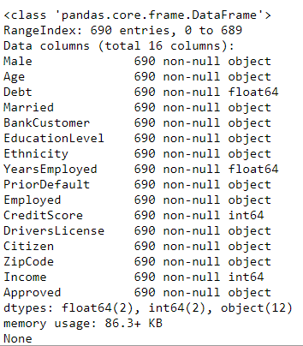
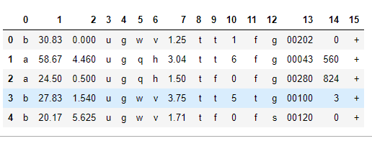
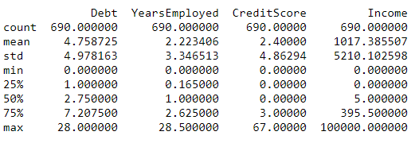
Exploratory Analysis
Variables in the dataset
Glimpse of the dataset and descriptive statistics

Slide 6
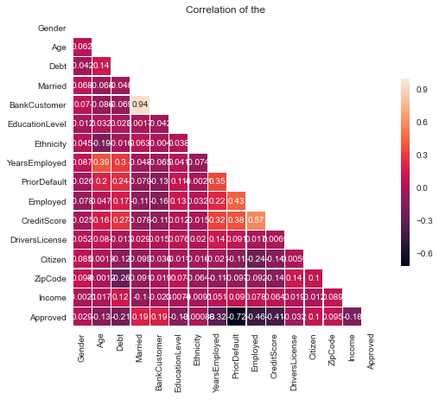
Exploratory Analysis
Correlation matrix

Slide 7
Feature Engineering
Machine learning models perform well with less number of features. So, we should select the most relevant features for the model.
Encoding: I used the labelencoder to convert non-numeric data to numeric.
Lets scale the features to a standard scaler so that machine learning models would learn from the data effectively.

Slide 8
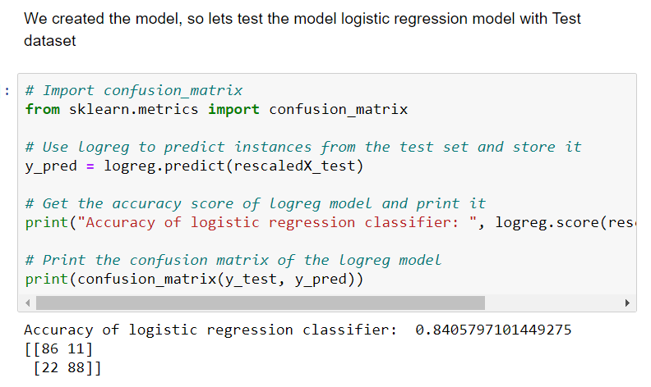
Modeling & Evaluation
Logistic Regression
Best score: 0.852174 using parameters {'max_iter': 100, 'tol': 0.01}

Slide 9
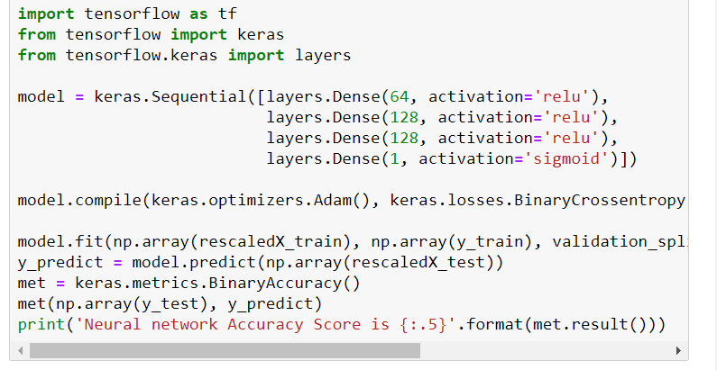
Modeling & Evaluation
Neural Networks
Neural Network also gave me similar accuracy (85%).

Slide 10

Please refer the paper for more technical details. Thank you!

